Slide 1

Grastech
Industrial Training
ANKITA, BBD University
PRESENTED BY
ANKITA
1220432130

Slide 2
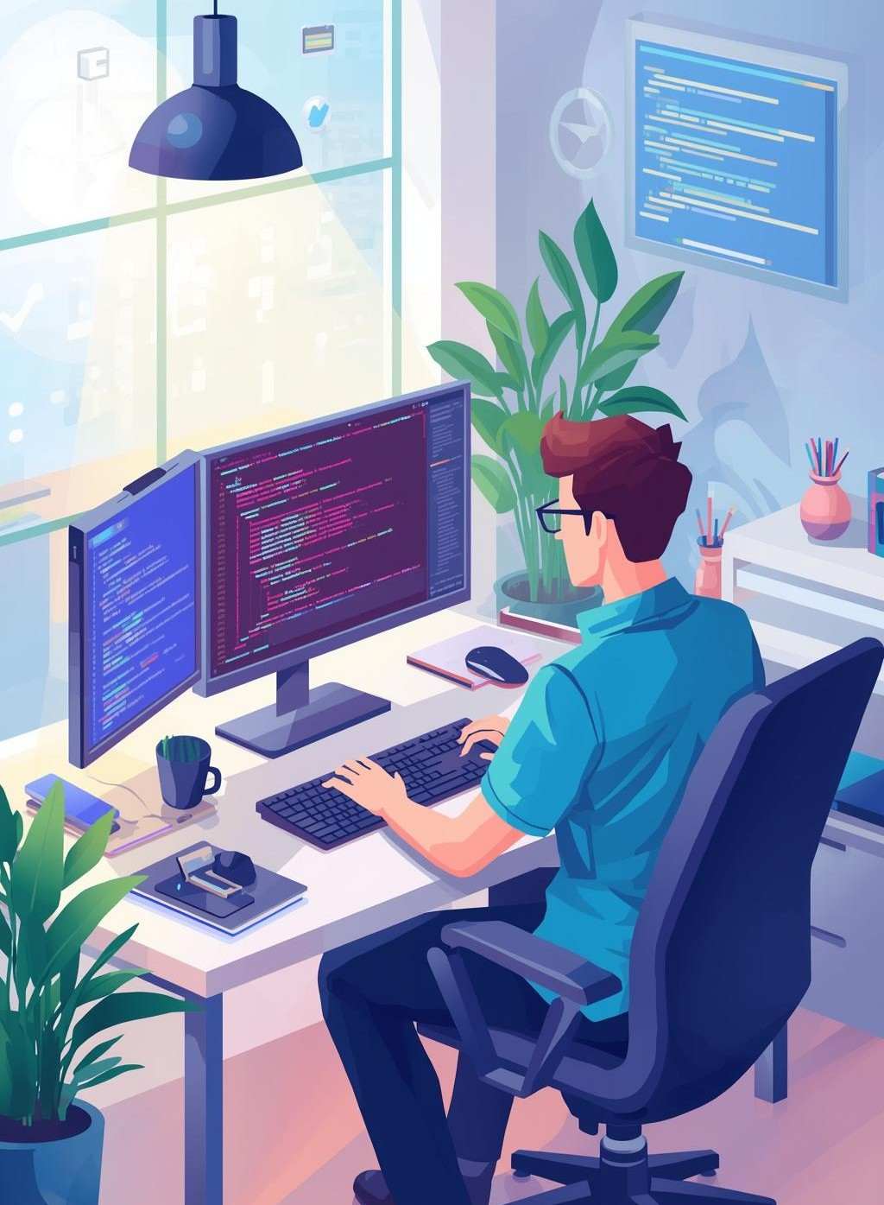
About the Training
The training spanned two months, focusing on Full Stack Web Development with the MERN stack, equipping me with vital skills through hands-on projects and real-world scenarios.

Slide 3
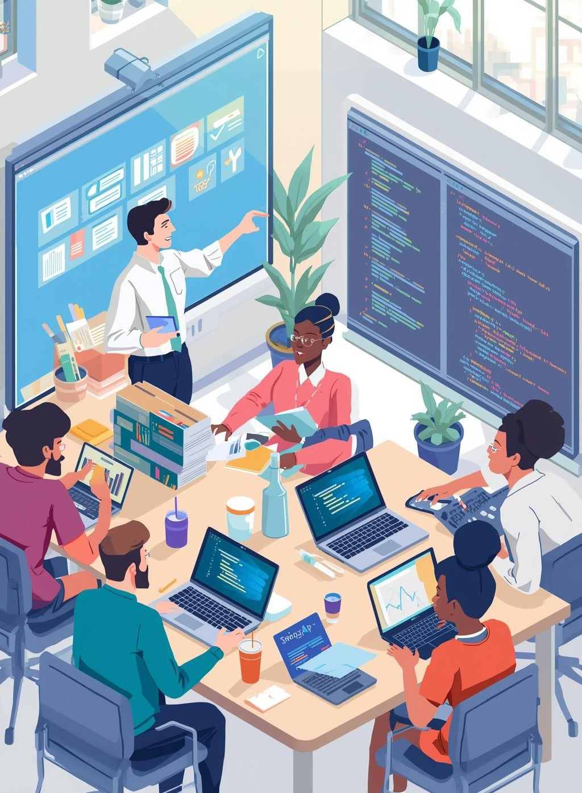
Grastech Overview
Grastech excels in professional training and development, offering hands-on learning experiences across various tech fields, ensuring students gain vital skills for today's industry demands.

Slide 4

Objectives of Training
The training aimed to provide practical exposure to full stack web development, focusing on frontend, backend, and database integration while enhancing problem-solving and project management skills.

Slide 5
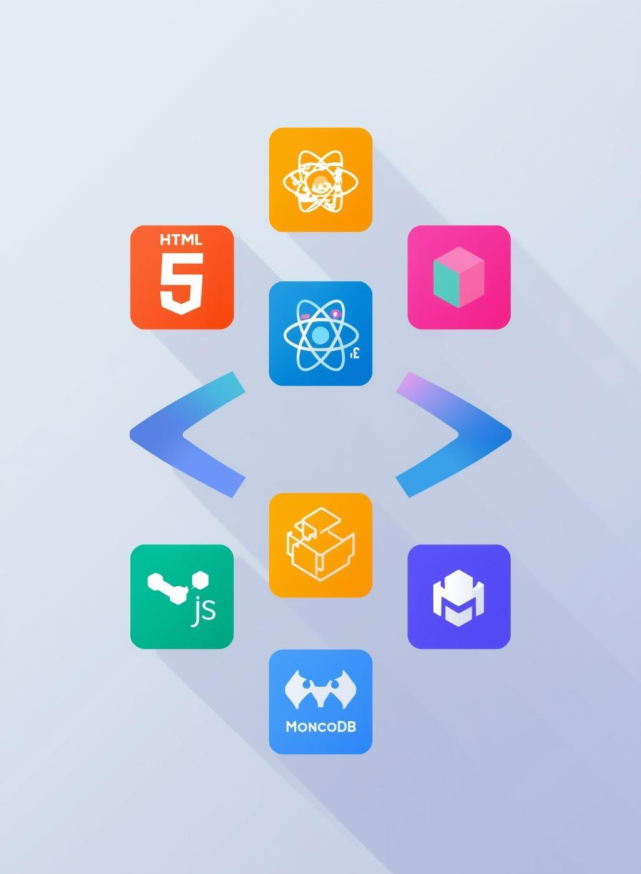
Tools and Technologies
This section outlines the essential tools and technologies utilized for full stack development, focusing on frontend, backend, and database integration to create dynamic web applications.

Slide 6
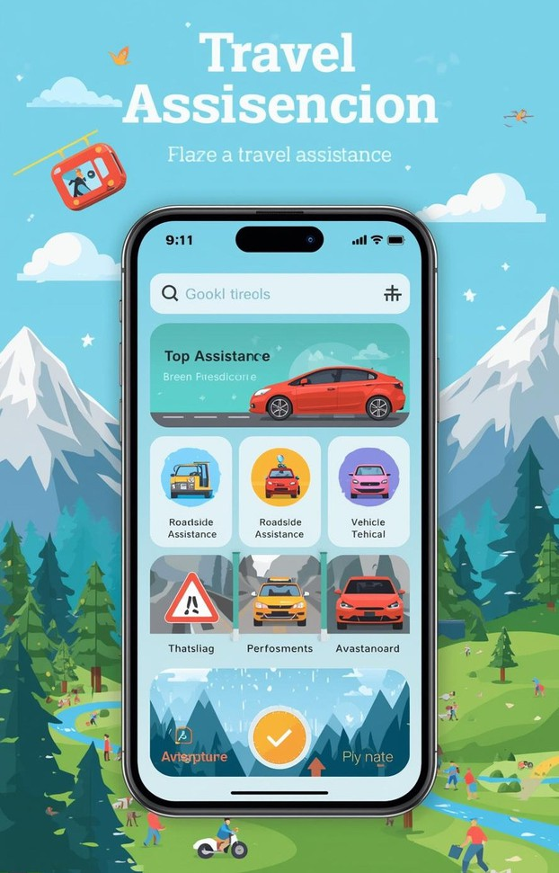
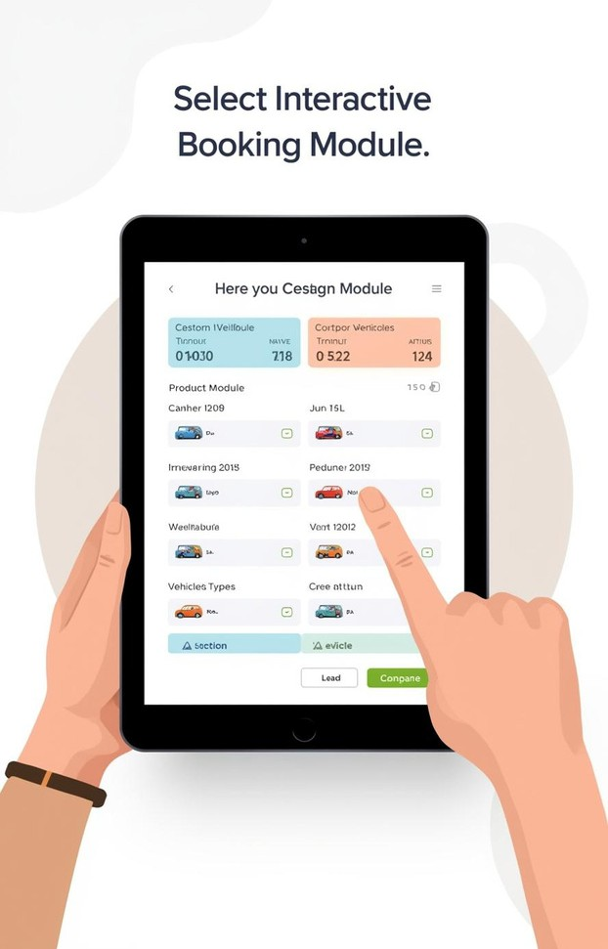
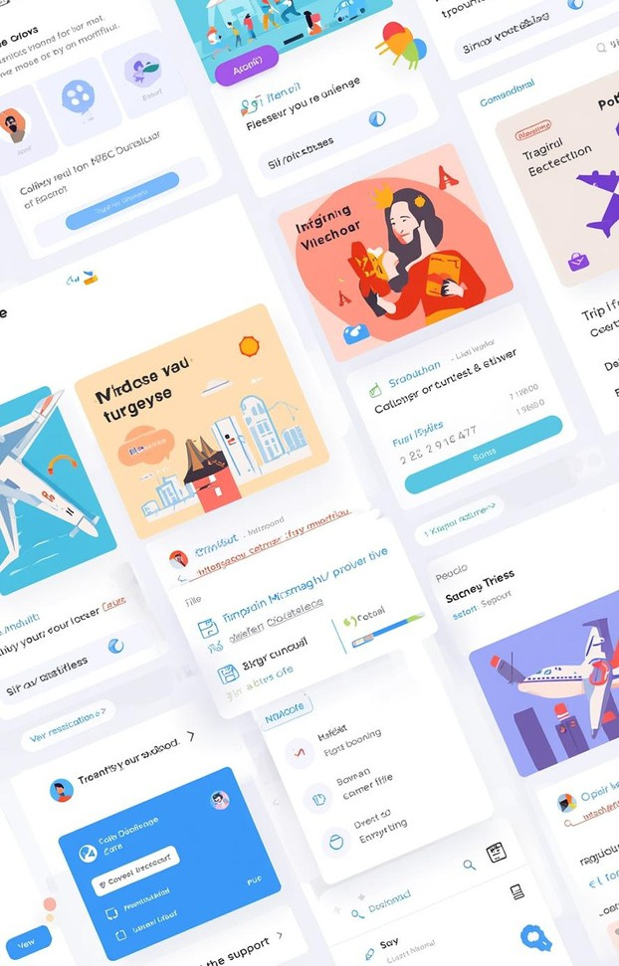
Project 1: Travel Adventure
APP INTERFACE
User-friendly design
BOOKING MODULE
Seamless experience
USER DASHBOARD
Real-time updates

Slide 7
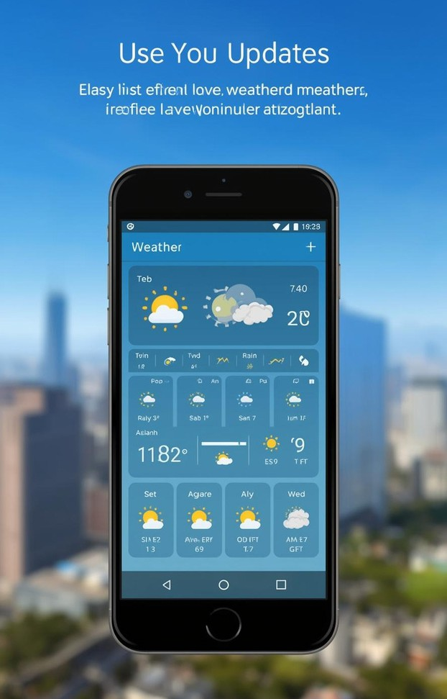
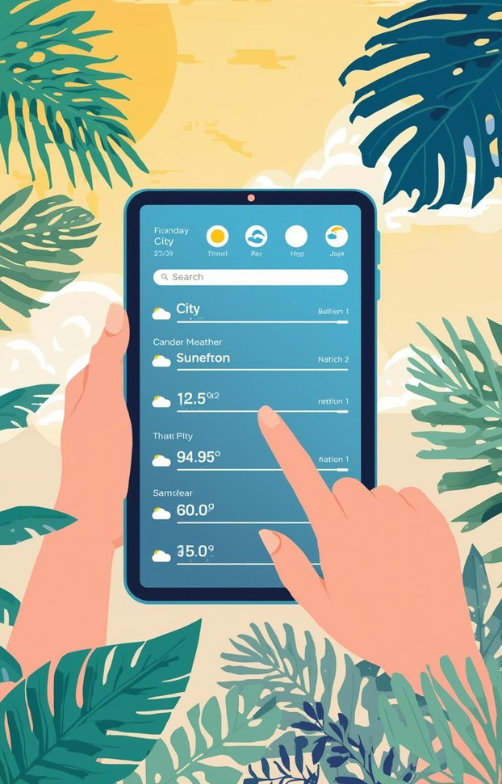
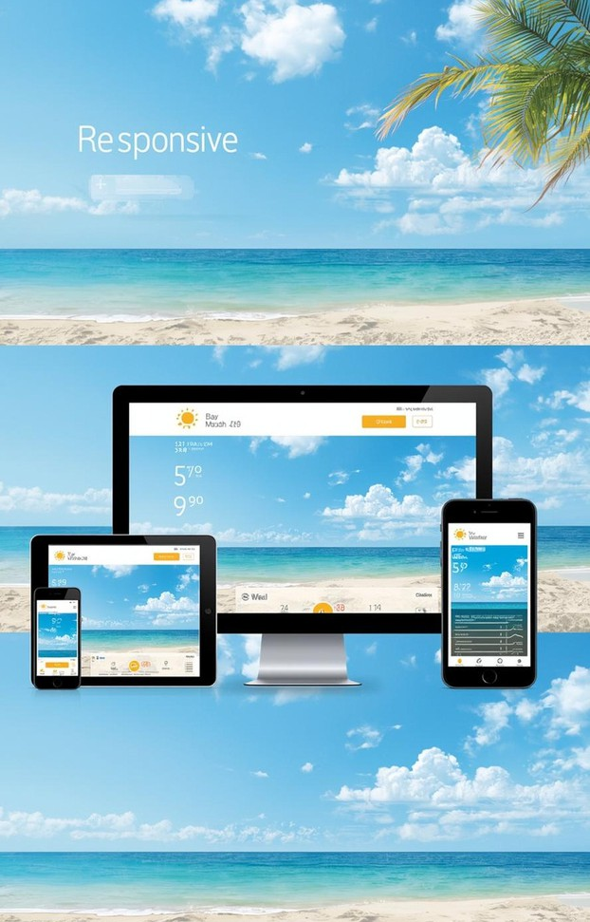
Weather App Features
REAL-TIME UPDATES
Live data
CITY-BASED SEARCH
Location queries
RESPONSIVE DESIGN
Mobile-friendly layout

Slide 8
Week-Wise Breakdown
HTML/CSS
JAVASCRIPT
API USAGE
Covered fundamental concepts of HTML5 and CSS3, focusing on responsive design techniques for modern web applications.
Explored JavaScript basics including ES6 features, DOM manipulation, and event handling for interactive web design.
Learned to utilize the Fetch API for accessing external data, ensuring efficient integration of various APIs into projects.

Slide 9
Project Development Process
VERSION CONTROL
UI/UX DESIGN
API INTEGRATION
Focused on designing interactive components and ensuring a responsive layout using React and Tailwind CSS for optimal user experience.
Integrated backend APIs using Express.js, ensuring seamless data flow between the frontend and backend for dynamic content updates.
Managed project files and updates using Git, maintaining version control through regular commits and push operations to GitHub repositories.

Slide 10

Challenges Faced
During the training, significant challenges arose in backend integration and UI design, impacting project timelines and requiring innovative problem-solving techniques to overcome obstacles effectively.

Slide 11

Key Learnings
Throughout this training, I gained valuable skills in full stack development, enhancing my confidence in real-world applications and solidifying my understanding of essential technologies.

Slide 12

Contact Information
ANKITA
ankitatripathi7@gmail.com
BBD UNIVERSITY
0-(522)-619622
SOFTWARE DEVELOPMENT
info@grastech.in

